Slide 1
DS404-SESSION 2
INTRODUCTION TO DATA STRUCTURES AND ARRAYS

Slide 2
WHAT WILL BE COVERED IN THIS SESSION?
What are Data Structures,why are they used and its types.
Applications of different Data Structures
Introduction to Arrays
Applications of Arrays
CP Problems on Arrays(Easy and Medium level)

Slide 3
Data Structures
Program=Algorithm + ”Data Structures”
In simple words it is the part of a program to store and represent elements of data along with the relationships existing between them.

Slide 4
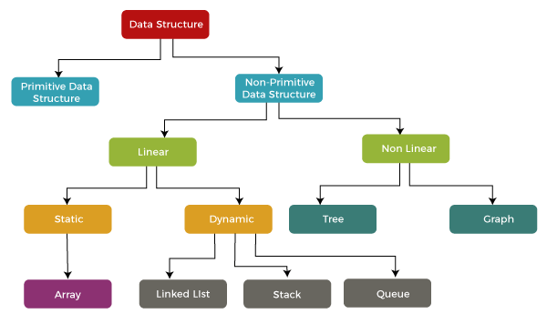
TYPES OF DATA STRUCTURES

Slide 5
PRIMITIVE AND NON-PRIMITIVE DATA STRUCTURES
Primitive data structures
These are basic structures which are operated by machine instructions and also they have different representations in different computers. Eg: Character, Integer, Pointer, Floating point etc. (Basically the datatypes it is!!)
Non-Primitive data structures
These structures are derived from primitive data structures.They deal with grouping homogeneous and heterogeneous data items efficiently. Eg: Arrays, Linked list etc.

Slide 6
PRIMITIVE DATA STRUCTURES
Types
Integer, Float, Character, Pointer
Each structures store its respective data type but a single value can be stored.
Pointers are used to store address of variables which contain data values.

Slide 7
NON-PRIMITIVE DATA STRUCTURES
TYPES
1.LINEAR
a) Static-Array
b) Dynamic-Linked List, Stack, Queue
2.NON-LINEAR
a) Graph
b) Tree

Slide 8
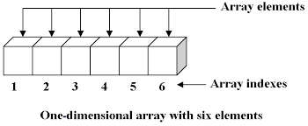
Linear Data Structures : Static-ARRAYS
It is a type of linear data structure which can store multiple values of data of single type in unique indices present inside it.
In other words it is a data structure used to store only homogenous data.
Data values are referenced by index values
The size of the array is pre-defined and cannot be changed dynamically.

Slide 9
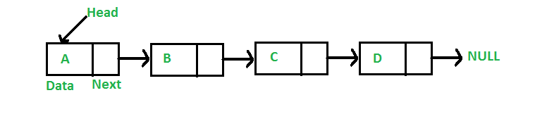
Linear Data Structures : Dynamic-Linked list
Data structure which consists of nodes connected one after the other where each node consists of the data value in the value field and the address to the next node in the address field.
A pointer called head points to the first node.
The address field of the last node will be NULL.

Slide 10
TYPES OF LINKED LISTS
Singly linked list (normal linked list)
Doubly linked list (each node will have 2 address fields ie link to next node and previous node)
Circular linked list (the last node address field will not be NULL instead it will connected to the first node)
Circular Doubly linked list (list with characteristics of both circular linked list and doubly linked list)

Slide 11
Linear Data Structures : Dynamic-Stack
It is an ordered collection of elements like arrays but has a special feature that allows insertion and deletion of elements only through one end.
Elements are stacked one over the other.
A pointer called top will be pointing to the topmost element in the stack.
Insertion and deletion follows LIFO(last in first out) method

Slide 12
There are two operations which can be done on stack
a)Push() - to add a new data value to the top of stack and further update(increment) the top pointer.
b)Pop() - delete a data value from the top of the stack and further decrement the top pointer.
c)peek() - to return data value/element to which top pointer is pointing.
Stack can be implemented using arrays(static implementation) or pointers(dynamic implementation).

Slide 13
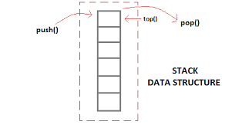
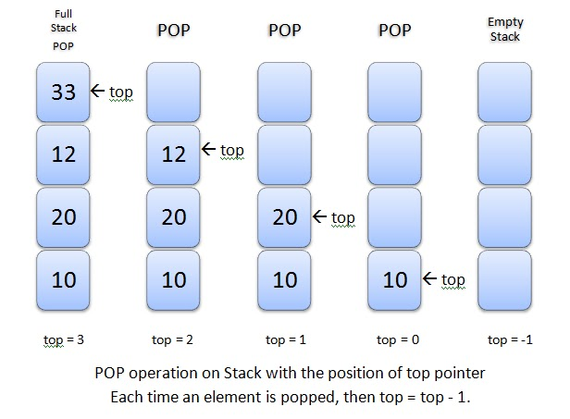

Slide 14
Linear Data Structures-Dynamic-Queue
->It is an ordered collection of elements like arrays but has a special feature that allows insertion and deletion of elements only through one end respectively.
->Elements are queued one behind the other.
->Two pointers called front and rear will be pointing to first and last element respectively.
->Operations performed follow FIFO(first in first out) method.

Slide 15
Main Operations performed on Queue
1.Enqueue()-to add an element/data value to the rear of queue and update the rear pointer
2.Dequeue()-to remove an element/data value from the front of the queue and update the front pointer.
Types of Queue
1.Circular queue-front and rear pointer are connected
2.Priority queue-elements stored are manipulated based on their priority
3.Deck/Deque-elements can be added/removed from both ends of queue.

Slide 16
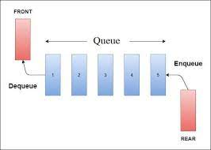

Slide 17
Stack
Queue
V
W
X
D
Y
C
Z
B
A

Slide 18
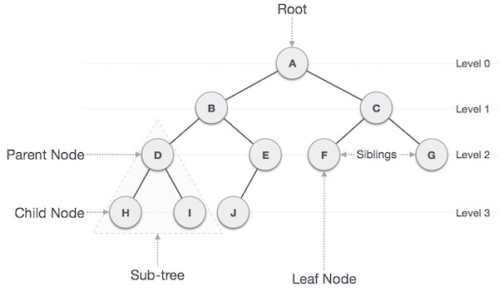
NON-LINEAR DATA STRUCTURE-TREE

Slide 19
->Data Structure in which elements are arranged in a hierarchical manner.
->The elements may/may not be arranged in sorted order and are stored in nodes.
->The is a special data item at the top of hierarchy called the Root.
->The remaining elements are arranged in mutually exclusive subsets(disjoint),each of which itself is a tree(also called subtree).
->In a tree there will be parent,child nodes and siblings which is self explanatory from the previous figure.
BINARY TREE
In a binary tree each node has atmost 2 children.

Slide 20
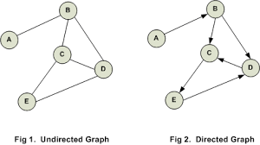
NON-LINEAR DATA STRUCTURE-GRAPH

Slide 21
->A graph is a data structure which contains a set of vertices(V) and a set of edges(E),which can be represented as graph(G)=(V,E)
->All the data values/elements will be stored in vertices(nodes) and they will connected using the Edges existing b/w them.
->If there is a direction assigned to the Edges then its called directed graph/digraph.
Types of Graph
1.Directed graph, 2.Non-Directed Graph, 3.Connected Graph, 4.Non-Connected Graph, 5.Simple Graph, 6.Multi-Graph.

Slide 22
APPLICATION OF DIFFERENT DATA STRUCTURES
LINEAR
->Arrays-CPU scheduling,sorting operations,matrix operations etc.
->Linked list-Dynamic memory allocation,polynomial addition etc.
->Stack-browser history management,expression evaluation etc.
->Queue-CPU scheduling,Breadth first search etc.
NON-LINEAR
->Graph-resource allocation graph(in operating systems),google maps(for finding shortest path) etc.
->Tree-binary search tree,trie etc.

Slide 23
THAT’S IT FOR DATA STRUCTURES!!
NOW TIME FOR ARRAYS IN SPECIFIC!!

Slide 24
Which of the following correctly declares an array?
a)int a[20];
b)int a;
c)a{20};
d)array a[20];

Slide 25
INTRODUCTION TO ARRAYS
It is a linear static data structure which stores homogenous data.
Its static because the size given cannot be changed during runtime.
numbers,strings,boolean values,objects,characters can be stored in an array.
Arrays can be 1-D,2-D..or multidimensional!
The index values of array start from 0 and goes upto ‘n-1’ , if size of array is n.

Slide 26
DECLARATION OF ARRAYS
Syntax–1-D Arrays
<datatype> <array_name>[size]; //to declare just the array without elements.
<datatype> <array_name>[ ]={val0,val1,val2….}; //Array declaration by initializing elements.
<datatype> <array_name>[size ]={val0,val1,val2….valsize-1}; //Array declaration by initializing elements and declaring size.

Slide 27
Syntax-2-D Arrays and Multidimensional Arrays
<datatype> <array_name>[dimension 1 size ][dimension 2 size]; //syntax for 2-d array declaration
<datatype> <array_name>[dimension 1 size][dimension 2 size]......[dimension n]; //syntax for multidimensional array declaration.
Examples
int a[5];
int a[ ]={10,20,30,40};
int a[5][7];

Slide 28
A program P reads in 500 integers in the range [0,100] representing the scores of 500 students. It then prints the frequency of each score above 50. what would be the best way for P to store the frequencies?
(a) An array of 50 numbers
(b) An array of 100 numbers
(c) An array of 500 numbers
(d) A dynamically allocated array of 550 numbers

Slide 29
TRAVERSAL & INSERTION OF ELEMENTS INTO ARRAY
There are two methods by which we can enter elements to the array.
1)manually entering elements by choosing index value(without loop).
Syntax
<array_name> = value;
this method is usually used to update the values in array.

Slide 30
Example code for first method
#include <stdio.h>
void main(){
int a[ ] = {5,6,7,8};
cout<<a[1]<<”\n”; //the output will be 6
a[1]=10;
cout<<a[1]<<”\n”; //the output will be 10
}

Slide 31
2)iterating/traversing through each index using a loop and entering the desired values.
Generally we use for loop or while loop to iterate through the array and add elements.
Syntax
For loop
Assume an array a of size n exists with no elements in it.
for(int i=0;i<n;i++){ //i is the iterator here which access the indices of the array.
cin>>a[i];
}

Slide 32
While loop
Assume an array ‘a’ of size n,we declare an iterator ‘i’ outside the loop.
Code
int a[n];
int i=0; //iterator declared and initialized to 0
while(i<n){
cin>>a[i];
i++;
}

Slide 33
PRINTING OF ELEMENTS OF ARRAY
Same method of entering elements is used here only difference is that instead of ‘cin’ statement in the code in previous slides we use ‘cout’ statement.
Example code
1.
int a[ ]={2,3,4};
cout<<a[2]; //output is 2

Slide 34
2.
Int a[ ]={1,2,3,4};
for(int i=0 ; i<4 ; i++){
cout<<a[i]<<” “;
}
// output is ‘1 2 3 4’

Slide 35
Sum of elements in 2d array.
int a[3] [3]={1,2,3,4,5,6,7,8,9};
int sum=0;
for(int i=0 ; i<3 ; i++){
for(int j=0;j<3;j++){
sum=sum+a[i][j];
}
}
cout<<sum;
//sum is 45.

Slide 36
An n*n array V is defined as follows V[i,j]=i-j for all i,j, 1<=i<=n;1<=j<=n;
The sum of the elements of the array V is
(a) 0
(b) n-1
(c) n2-3n+2
(d) n2(n+1)/2

Slide 37
APPLICATION OF ARRAYS
Cpu Scheduling-used to stored the burst time,turnaround time etc to help the processor allocate cpu to different processes.
Sorting operations-Used in various sorting operations for intermediate calculations and manipulations etc.
Matrix calculations-calculations will be done using 2d arrays in general
Database records are implemented using arrays.

Slide 38
Done with theory :)
Time for solving cp problems!!

Slide 39
THANK YOU!!!

